Slide 1
Zigbee and 802.15.4 Tutorial
Ravi Prakash
Ravi Prakash

Slide 2
802.15.4 General Characteristics
Data rates of 250 kb/s, 40 kb/s and 20 kb/s.
Star or Peer-to-Peer operation.
Support for low latency devices.
CSMA-CA channel access.
Dynamic device addressing.
Fully handshaked protocol for transfer reliability.
Low power consumption.
Frequency Bands of Operation
  16 channels in the 2.4GHz ISM band
  10 channels in the 915MHz ISM band
  1 channel in the European 868MHz band.
Ravi Prakash

Slide 3
802.15.4 Architecture
Upper Layers
IEEE 802.2 LLC
Other LLC
IEEE 802.15.4 MAC
IEEE 802.15.4
IEEE 802.15.4
868/915 MHz
2400 MHz
PHY
PHY
Ravi Prakash

Slide 4
Operating Frequency Bands
Channel 0
Channels 1-10
868MHz / 915MHz
PHY
2 MHz
868.3 MHz
902 MHz
928 MHz
2.4 GHz
PHY
Channels 11-26
5 MHz
2.4 GHz
2.4835 GHz
Ravi Prakash

Slide 5
IEEE 802.15.4 Device Classes
Full function device (FFD)
  Any topology
  Network coordinator capable
  Talks to any other device
Reduced function device (RFD)
  Limited to star topology
  Cannot become a network coordinator
  Talks only to a network coordinator
  Very simple implementation
Ravi Prakash

Slide 6
Star Topology
PAN
Coordinator
Master/slave
Full function device
Communications flow
Reduced function device
Ravi Prakash

Slide 7
Peer-to-Peer Toplogy
Point to point
Cluster tree
Full function device
Communications flow
Ravi Prakash

Slide 8
IEEE 802.15.4 Addressing
All devices have 64-bit IEEE addresses
16-bit short addresses can be allocated
Addressing modes:
  Network + device identifier (star)
  Source/destination identifier (peer-peer)
Ravi Prakash

Slide 9
IEEE 802.15.4 Superframe Structure
GTS 1
GTS 2
Contention Access Period
Contention Free Period
Inactive Period
15ms * 2^{n}
where 0 ≥ n ≥ 14
Network beacon
Transmitted by network coordinator. Contains network information,
frame structure and notification of pending node messages.
Beacon extension
period
Space reserved for beacon growth due to pending node messages
Contention period
Access by any node using CSMA-CA
Guaranteed
Time Slot
Reserved for nodes requiring guaranteed bandwidth.
Ravi Prakash

Slide 10
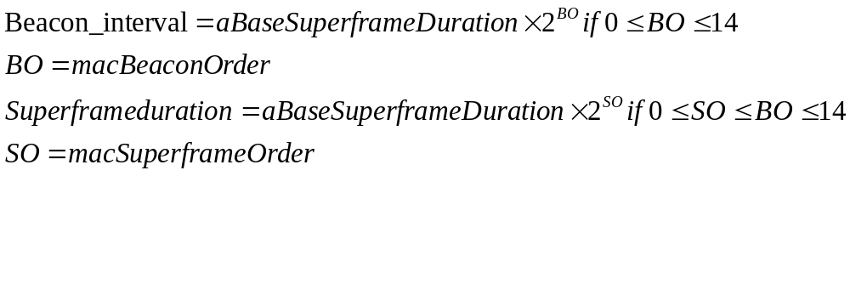
Superframe Structure
PANs that do not wish to use the superframe structure (nonbeacon-enabled PANs) set BO and SO to 15.
Ravi Prakash

Slide 11
CSMA-CA
Use slotted version if beacons are being used.
Otherwise, use unslotted version.
Unlike 802.11 MAC, don’t freeze counter id if medium is busy during countdown.
Need to sense two consecutive idle slots, following countdown, before transmission.
Ravi Prakash

Slide 12
CSMA-CA (contd.)
Battery save mode: start with backoff exponent in the range [0..2], instead of macMinBE.
Ravi Prakash

Slide 13
Starting and Maintaining a PAN: Channel Scan
ED scan: measure peak energy on each specified channel.
Active channel scan:
  Send a beacon request command and wait for response.
  Enables FFD to locate any coordinator transmitting beacon frames within its POS.
Passive channel scan.
  No beacon request command sent.
Orphan channel scan.
  Allows device to relocate its coordinator following loss of synchronization.
Ravi Prakash
Notes:
In active channel scan the coordinator of beacon-enabled PAN ignores beacon request command. The coordinator of nonbeacon-enabled PAN transmits a single beacon frame on receiving the command.
For both active and passive scans, the scanning of a channel terminates when the number of beacons found equals the implementation specified limit, or the channel has been scanned for the full time.
Entire scan terminates when the number of PAN descriptors stored equals the implementation specified maximum, or every channel in the set of available channels has been scanned.

Slide 14
Orphan Channel Scan
Device action for each specified channel:
  Send orphan notification command.
  Wait at most aResponseWaitTime.
  If coordinator realignment command received, disable receiver.
Coordinator on receiving orphan notification:
  Sends realignment command if it finds the device in its device list.
  Realignment command contains PANid, logical channel, short address of orphaned device.
Ravi Prakash

Slide 15
PAN Initiation
FFD starts a PAN after performing active channel scan and selecting a suitable 16-bit PAN identifier.
Beacon-enabled PAN:
  PAN coordinator and all other FFDs that are part of a PAN transmit beacons once per superframe duration.
  Beacon contains macPANId.
    Non-coordinators set PANcoordinator parameter to FALSE.
Ravi Prakash

Slide 16
Association by a Device
Perform active or passive channel scan.
Select suitable PAN to associate with.
Send associate request to PAN coordinator.
Coordinator sends ACK confirming receipt.
Coordinator determines whether to allow association within aResponseWaitTime.
If sufficient resources available: allocate a short address.
Send response (success/failure) using indirect transmission.
Ravi Prakash

Slide 17
Disassociation
When a device wishes to leave PAN.
When coordinator wants one of its associated devices to leave the PAN.
  Send disassociation notification command through indirect transmission.
Ravi Prakash

Slide 18
Synchronization
With beacons:
  Search for beacons for at most aBaseSuperframeDuration*(2^{n}+1) symbols.
  Track beacons: activate device receiver just before known start time of next superframe.
Without beacons:
  Device polls coordinator for data.
Orphaned device realignment:
  Perform orphan scan.
  If successful, update PAN information.
  Otherwise, decide whether to retry orphan scan or attempt to reassociate.
Ravi Prakash

Slide 19
Transaction Handling: Indirect Transmission
Coordinator lists addresses of devices with which each transaction is associated.
Transaction persists in coordinator for at most macTransactionPersistenceTime.
Listed devices send data request to coordinator during the CAP.
Coordinator sends ACK.
Coordinator tries to send data to device using CSMA-CA (non CSMA-CA options also exist).
Ravi Prakash
Notes:
As 802.15.4 devices are energy-poor, it is left up to the devices to initiate transactions. The coordinators only indicate if they have data pending. Then, devices can retrieve it at their own discretion. Alternatively, devices can poll the coordiator.
Non CSMA-CA based response is when the coordinator finds that it can send the response within a very short period of time.
In a data or a MAC command frame, if a device is associated and has been assigned a 16-bit short address, it shall use that address in preference to its 64-bit extended address.
If the source (destination) address field is not present, it means that the source (destination, respectively) is the PAN coordinator.

Slide 20
Guaranteed Time Slot (GTS)
GTS allocated only by a PAN coordinator.
Used only for communication between PAN coordinator and device.
Up to 7 GTSs can be allocated at a time.
Devices allocated GTS can also operate in the CAP.
Ravi Prakash
Notes:
GTS direction is from the point of view of the device. Transmit means from device to coordinator. Receive implies the reverse direction.

Slide 21
GTS Allocation
Device makes request for GTS.
PAN coordinator:
  ACKs receipt of request.
  Makes decision within aGTSDescPersistenceTime superframes.
  Sends GTS descriptor in beacon for aGTSDescPersistenceTime superframes.
Device tracks beacons for these superframes.
If no GTS descriptor for device appears in this time: failure indicated to higher layer of stack.
Ravi Prakash

Slide 22
GTS use by Device
Beacon missed: do not use its GTS.
Loss of synchronization: consider all its GTSs deallocated.
No fragmentation of CFP:
  Any gaps occurring in the CFP due to a GTS deallocation are removed to maximize length of CAP.
Ravi Prakash

Slide 23
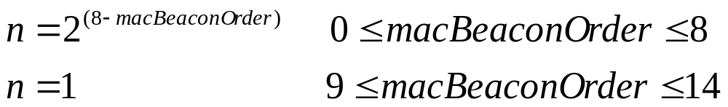
GTS Expiration
Transmit GTS: if coordinator does not receive data at least once every 2n superframes.
Receive GTS: If ACK not received at least once every 2n superframes.
Ravi Prakash

Slide 24
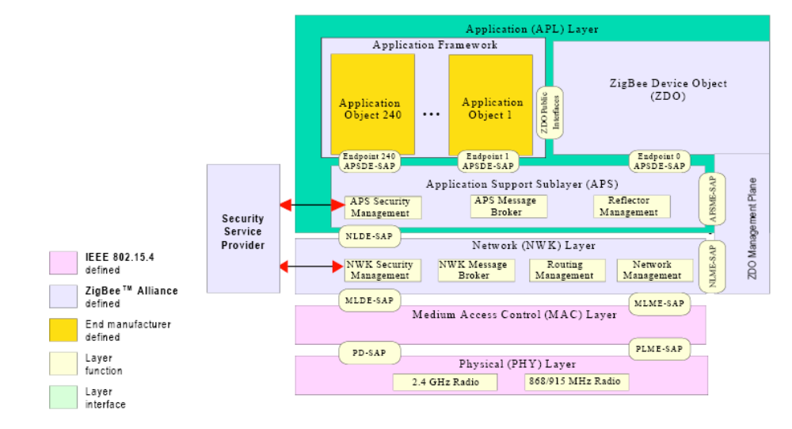
ZigBee Stack Architecture
Ravi Prakash

Slide 25
Application Level Specification
Endpoint 0: reserved for device management.
Endpoints 1-240: used to identify individual objects within a device.
Profile: agreement on messages, message formats and processing actions that enable applications residing on separate devices to create an interoperable, distributed application.
Ravi Prakash
Notes:
Endpoints look like port numbers in the TCP/IP protocol stack.

Slide 26
Device Discovery
Network address request: broadcast.
  Carries known IEEE address.
IEEE address request: unicast.
  Assumes network address is known.
Responses:
  End devices: respond with corresponding address.
  ZigBee coordinator/router: respond with their own corresponding address, and the corresponding addresses of all devices that are associated with them.
Ravi Prakash

Slide 27
Service Discovery and Binding
Service discovery: services available on endpoints at the receiving device are discovered by external devices.
Binding: logical link between complementary applications and endpoints.
  Maintained as a table in the ZigBee coordinator.
  Examples:
    Thermostat and furnace controller.
    Switches and lamps.
Ravi Prakash

Slide 28
ZigBee Message Addressing
Direct addressing: radio address + endpoint.
  64-bit IEEE address + 16-bit PAN id + 8 bits.
Indirect addressing: used for energy savings.
  Source sends message to ZigBee coordinator without destination information.
  ZigBee coordinator refers to its binding table to extract destination information based on source address, endpoint, etc.
Broadcast addressing: application message broadcast to all endpoints of a given device.
Ravi Prakash

Slide 29
ZigBee: Network and Device Maintenance
All ZigBee devices shall provide functionality for joining and leaving network.
ZigBee coordinator and routers shall provide additional functionality to:
  Permit devices to join or leave.
  Participate in assignment of logical network address.
  Maintain a list of neighbors.
ZigBee coordinator shall provide the functionality to establish a new network.
Ravi Prakash

Slide 30
Establishing New Network
Perform ED scan over specified or default (all) set of channels.
Order channels by increasing energy measurement.
Discard those above an acceptable level.
Perform active scan on acceptable channels and review set of returned PAN ids.
Find first channel with lowest number of existing networks.
Select unique PAN id (2¹⁴ possible ids).
Set own 16-bit macShortAddress to 0x0000 (ZigBee coordinator).
Ravi Prakash
Notes:
Though the PAN id field is 16 bits long, the 2 most significant bits are reserved for future use. Also, 0xffff is the broadcast PAN identifier.

Slide 31
Devices Joining a Network
Parent: device with membership in network.
Child: new device joining the network.
Two ways to join:
  Joining through association.
  Joining directly.
Ravi Prakash

Slide 32
Joining through association: Child actions
MAC sublayer performs passive or active scan to obtain network information from beacons.
Network layer selects one of the networks that is willing to accept new devices.
JoinAsRouter parameter set to indicate if joining as ZigBee router or end device.
If more than one device can be parent, choose one at minimum depth to ZigBee coordinator.
If join attempt unsuccessful, repeat steps 2-4.
On successful join, obtains 16-bit short address from parent.
Device joining as router can begin transmitting beacons if BeaconOrder not equal to 15.
  Beacon contains PAN id, logical channel, BeaconOrder, SuperframeOrder values obtained from parent.
Ravi Prakash

Slide 33
Join through association: Parent actions
Does potential child device already exist in network?
  YES: issue association response to device with corresponding 16-bit address.
  NO: assign a unique 16-bit address to the new device if possible.
    Create entry for the device in neighbor table.
Ravi Prakash

Slide 34
Join Directly
Parent device is preconfigured with the 64-bit address of child device.
Is the device already part of the network?
  Yes: send indication to higher layer and terminate.
  No: assign 16-bit short address to device.
Child needs to make contact with parent by initiating the orphaning procedure.
Ravi Prakash

Slide 35
Orphaning Procedure
Child:
  Initiate orphan scan.
  If successful: inform application layer of success.
  Otherwise: inform network layer that no network found.
Parent:
  Is orphaned device a child (in neighbor table)?
    Yes: send 16-bit short address in response.
    No: indicate absence of match in response.
Ravi Prakash

Slide 36
Distributed Address Assignment
ZigBee coordinator determines the maximum number of children any network device is allowed to have (Cm).
  Of these at most how many can be router-capable (Rm).
Zigbee coordinator also determines maximum depth of network (Lm).
Parent at depth d provides every router-capable child with a finite sub-block of addresses (Cskip(d)).
Ravi Prakash

Slide 37
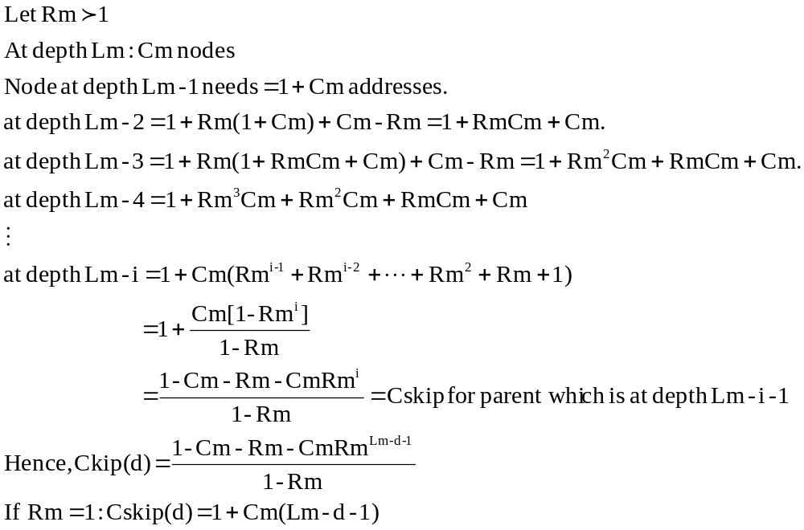
Cskip(d) derivation
Ravi Prakash

Slide 38
Cskip(d) derivation
Let
Rm

1
At
depth
Lm
:
Cm
nodes
Node
at
depth
Lm
-
1
needs
=
1
+
Cm
addresses.
at
depth
Lm
-
2
=
1
+
Rm(1
+
Cm)
+
Cm
-
Rm
=
1
+
RmCm
+
Cm.
at
depth
Lm
-
3
=
1
+
Rm(1
+
RmCm
+
Cm)
+
Cm
-
Rm
=
1
+
Rm
2
Cm
+
RmCm
+
Cm.
at
depth
Lm
-
4
=
1
+
Rm
3
Cm
+
Rm
2
Cm
+
RmCm
+
Cm

at
depth
Lm
-
i
=
1
+
Cm(Rm
i
-
1
+
Rm
i
-
2
+
☹
+
Rm
2
+
Rm
+
1)
=
+
Cm[1
-
Rm
i
]
1
1
-
Rm
=
1
-
Cm
-
Rm
-
CmRm
i
=
Cskip
for
parent whi
ch
is
at
depth
Lm
-
i
-
1
1
-
Rm
=
1
-
Cm
-
Rm
-
CmRm
Lm
-
d
-
1
Hence,
Ckip(d)
1
-
Rm
If
Rm
=
1
:
Cskip(d)
=
1
+
Cm(Lm
-
d
-
1)
Ravi Prakash

Slide 39
Address Assignment: depth d
Address of first router capable child: one greater than parent’s address.
Subsequent router capable children separated by Cskip(d).
N^{th} router capable child’s address(A_{Rn}) = A_{parent} + Cskip(d).(n-1) + 1
N^{th} end device’s address (A_{n}) =
A_{parent} + Cskip(d).Rn + n
Ravi Prakash
Notes:
Because an address sub-block cannot be shared between devices, it is possible that one parent exhausts its list of addresses while a second parent has addresses that go unused.

Slide 40
Alternative addressing mechanism
Addresses to be assigned by a device set by the next higher layer.
nwkAvailableAddresses: number of addresses the node is capable of assigning.
nwkNextAddress: address to be assigned to the next device that associates.
When next child associates:
  nwkAvailableAddresses decremented by 1.
  nwkNextAddress incremented by nwkAddressIncrement.
Ravi Prakash

Slide 41
Leaving the Network
Child can initiate its own removal from network.
  Send leave request to its children, too.
Parent can force a child to leave the network.
  Possible to recursively remove children (clean up the sub-tree).
Ravi Prakash

Slide 42
Beacon Scheduling
Prevent collision of beacon with other beacons and data frames.
Not applicable to mesh networks (no beaconing).
Beaconing permitted in tree networks.
Beacon order should be set much larger than superframe order, to save energy.
Schedule active portions of superframes of every device in neighborhood such that they are non-overlapping in time.
Ravi Prakash

Slide 43
Beacon Scheduling (contd.)
Each device, in its beacon, transmits the offset of its beacon from its parent’s beacon.
Possible to infer neighbor’s parent’s beacon transmission time from neighbor’s beacon.
New device chooses the time for its beacon and CAP such that the active portion of its superframe does not overlap with that of any neighbor or parent of any neighbor.
If non-overlapping period not available, new device operates as an end device.
Ravi Prakash

Slide 44
Parent-Child Communication
Communication between child and parent during parent’s CAP.
Transmission from parent to child using indirect transmission technique.
  Child tracks parent’s beacon.
  Extract information from parent during parent’s CAP.
Ravi Prakash

Slide 45
Network Density and Duty Cycle
Density of devices supportable in the network is inversely proportional to ratio of superframe and beacon orders.
Recommendation:
  Superframe Order = 0 ≡ Superframe duration = 15.3 ms.
  Beacon Order = 6-10 ≡ Beacon interval between 0.98304s and 15.72864s.
  Resultant duty cycle between 2% and 0.1%.
Ravi Prakash

Slide 46
Transmission and Reception
Transmission:
  In addition to source and destination addresses, all network layer transmissions include:
    Radius (default = nwkMaxDepth).
    Sequence number (inserted by source).
Reception:
  Beacon-enabled network: when not transmitting, device keeps its receiver enabled during active period of its superframe and its parent’s superframe.
  Nonbeacon-enabled network: receiver enabled when device is not transmitting.
Ravi Prakash

Slide 47
On Receipt of a Frame
Decrement radius by 1.
If resultant radius=0, frame cannot be transmitted, only processed locally.
If destination address = own address: pass to higher layer.
Broadcast data frames: passed to higher layer and relayed.
ZigBee coordinator and routers may also relay data frames for which destination address is not equal to device address (table lookup).
Ravi Prakash

Slide 48
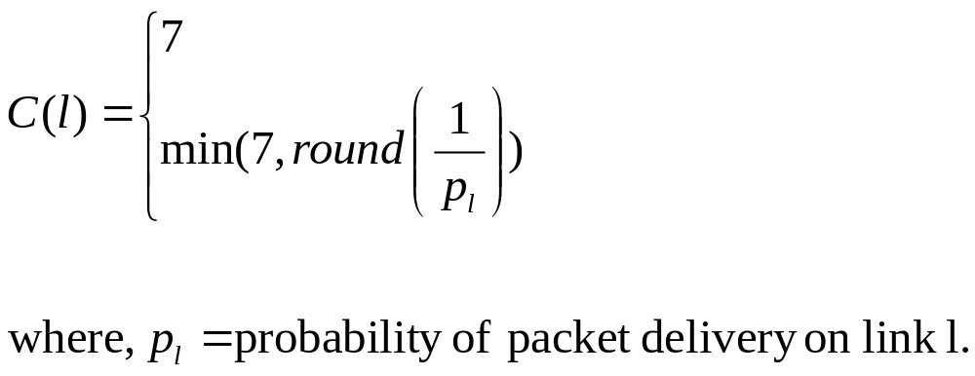
Routing
C(l): link cost
Path cost = sum of cost of links on the path.
Determination of p_{l} is an implementation issue.
Ravi Prakash
Notes:
In computing link costs, one option is to consider all links to have the same cost of 7. The other option is to represent the number of expected attempts required to send a packet along a link at the cost of the link. The number of expected attempts is the reciprocal of p_{l}. One concern: the standards document uses p_{l} raised to the fourth power in the expression. However, the description seems to imply that the fourth power is not needed.

Slide 49
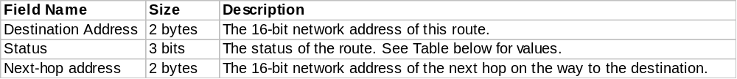
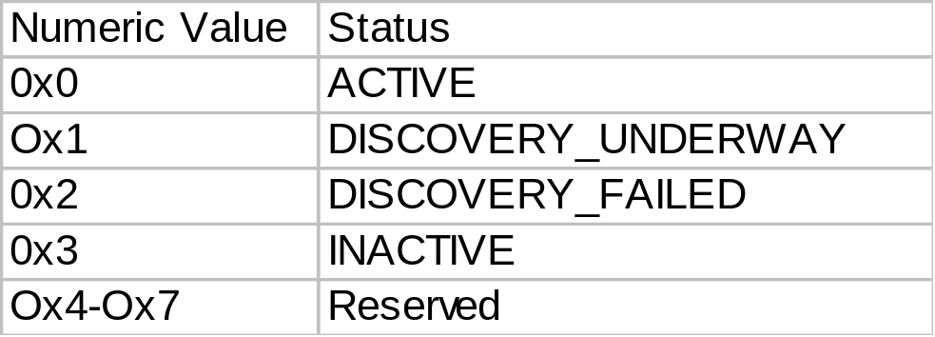
Routing Table
Ravi Prakash

Slide 50
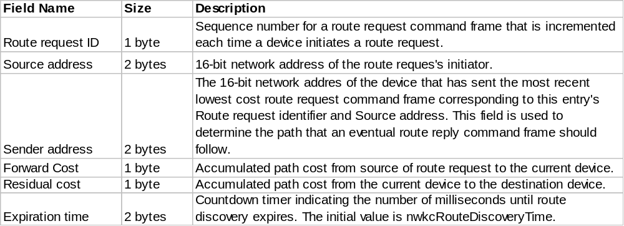
Route Discovery Table
Routing table entries: long lived.
Route discovery table entries last as long as a single route discovery.
Ravi Prakash
Notes:
A device has routing table capacity if:
It is a ZigBee coordinator or ZigBee router.
It maintains a routing table.
It has a free routing table entry or it already has a routing table entry corresponding to the destination.
The device is attempting route repair and it has reserved some entries for this purpose.
A device is said to have route discovery table capacity if:
It maintains a route discovery table.
It has a free entry in its route discovery table.
If a device has both routing table capacity and route discovery table capacity then it may be said to have “routing capacity.”

Slide 51
Route Discovery: Initiator
Add an entry to the route discovery table.
Set a route request timer.
Broadcast route request command nwkcInitialRREQRetries+1 times, separated by newcRREQRetryInterval milliseconds.
Ravi Prakash

Slide 52
Route Discovery: Other Nodes on receiving Route Request
Does route discovery table entry already exist?
  YES: Does the new request have lower forward cost?
    YES: forward request.
    NO: discard request.
  NO: if routing capacity then forward request.
Route request forwarded by broadcasting nwkRREQRetries+1 times.
Introduce jitter before forwarding.
Ravi Prakash
Notes:
Forward cost computed by adding the cost of the link along which request is received to the path cost of the request.

Slide 53
Route Discovery: Route Reply
Generated either by destination, or by ZigBee router that is parent of destination end-device.
On receiving route reply:
  If received RREP indicates a shorter path to destination (residual cost) than already known then update own entry and propagate RREP towards target of RREP.
  Otherwise, discard RREP.
Ravi Prakash

Slide 54
Route Repair
Maintain failure counter for each link to a neighbor.
Initiate route repair when failure counter exceeds a threshold.
Mesh network:
  Upstream device for the failed link initiates new route discovery for the device that is the destination of the frame that failed in transmission.
Tree network:
  Initiate orphaning procedure on losing synchronization.
  If device needs to acquire new network address, it recursively disassociates all its children first.
Ravi Prakash

Slide 55
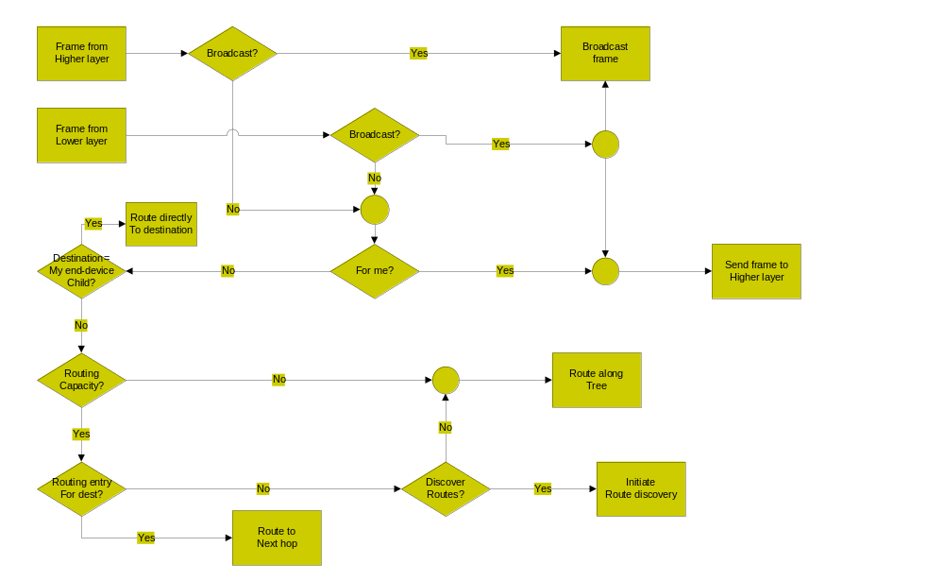
Basic Forwarding Algorithm
Ravi Prakash
Notes:
When a packet arrives for destination, if route status = DISCOVERY_UNDERWAY, then the frame is either buffered until route is discovered, or the frame is routed along tree using hierarchical routing.

